Slide 1
Stock Web Scraper

Slide 2
1
The Set-Up
The outline of our code

Slide 3
The Layout
Python Script
This is what is used to scrape.
It was the easiest way for us to accomplish web scraping
Javascript
Used to display the HTML
C++ main
This reads and writes the information collected from the python script which is later used to display with the javascript files

Slide 4
2 main.cpp
The actual C++ code

Slide 5
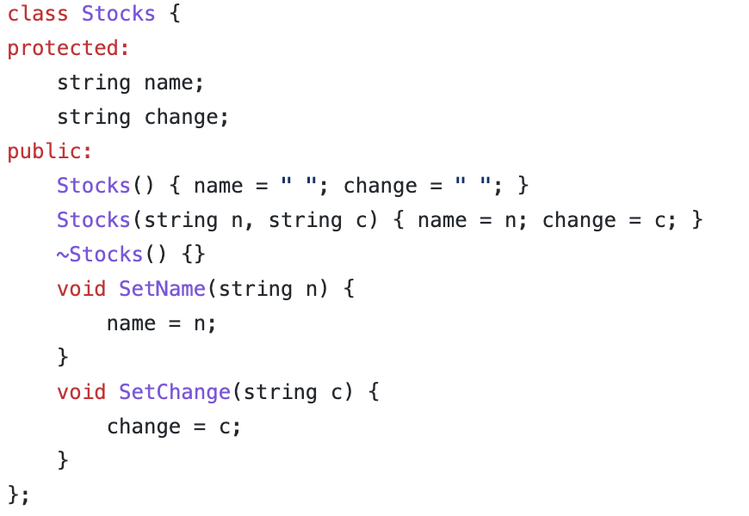
The Class -> Stocks
The stocks class has a name and change, meaning the company and value change.
Also includes constructors and functions

Slide 6
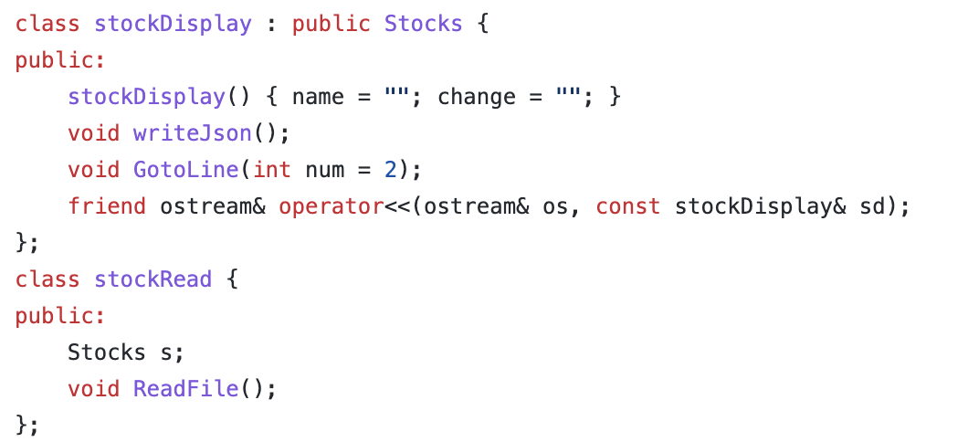
The Child Class StockDisplay
This inherits everything from the Stock Class along with the functions writeJson() and GotoLine()
It also has an operator overloading function that overloads the << operator

Slide 7
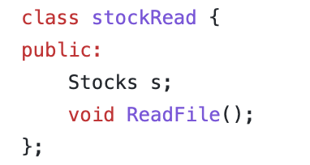
Class StockRead
Contains a Stock object and a function

Slide 8
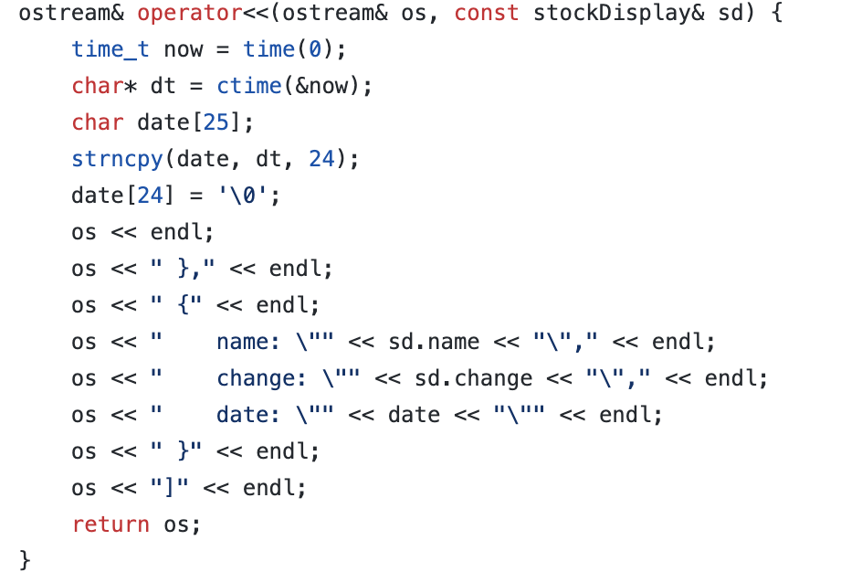
Operator Overloading ”<<”

Slide 9
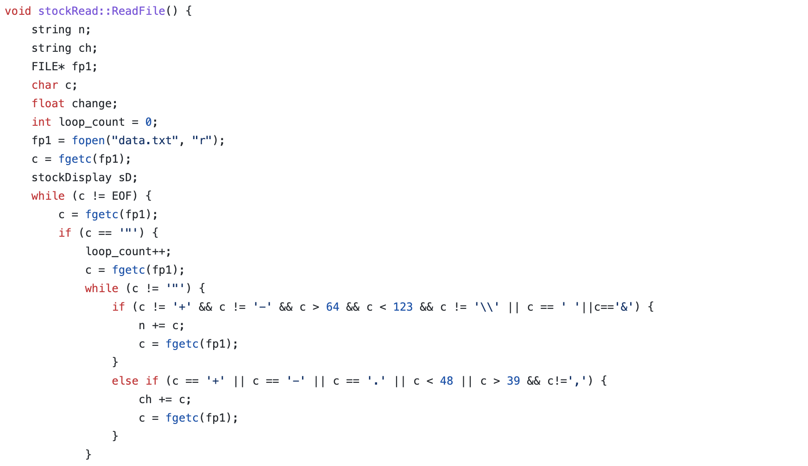
Read File -> Apart of the stockRead Class

Slide 10
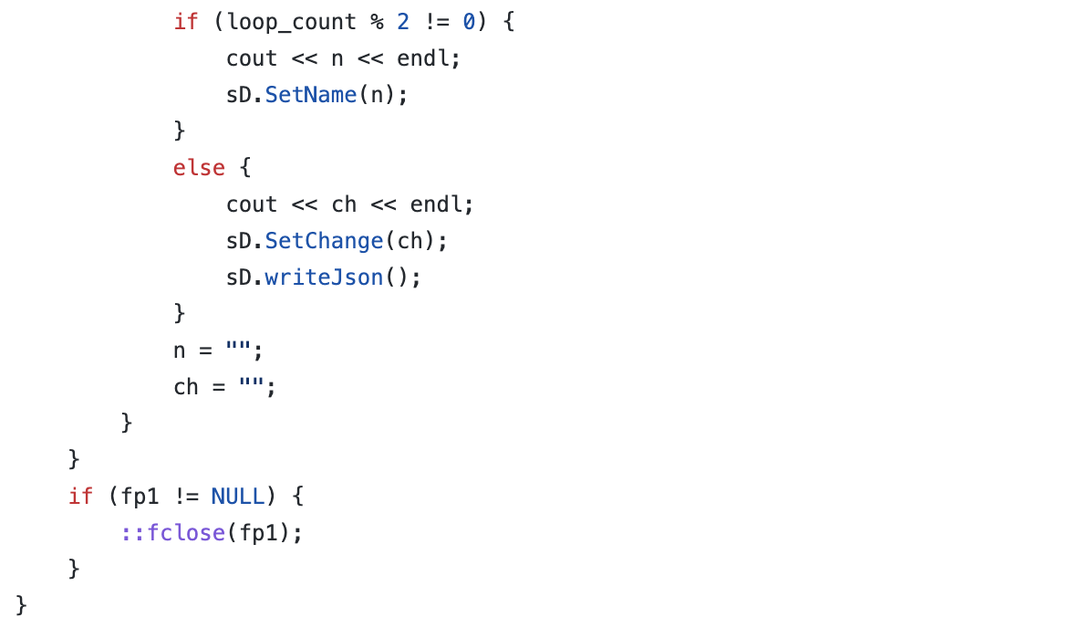
Read File -> Apart of the stockRead Class count.
Example "Paysafe Limited": ["+0.2600"]
To parse the information we ASCII values to separate the information into separate values.

Slide 11
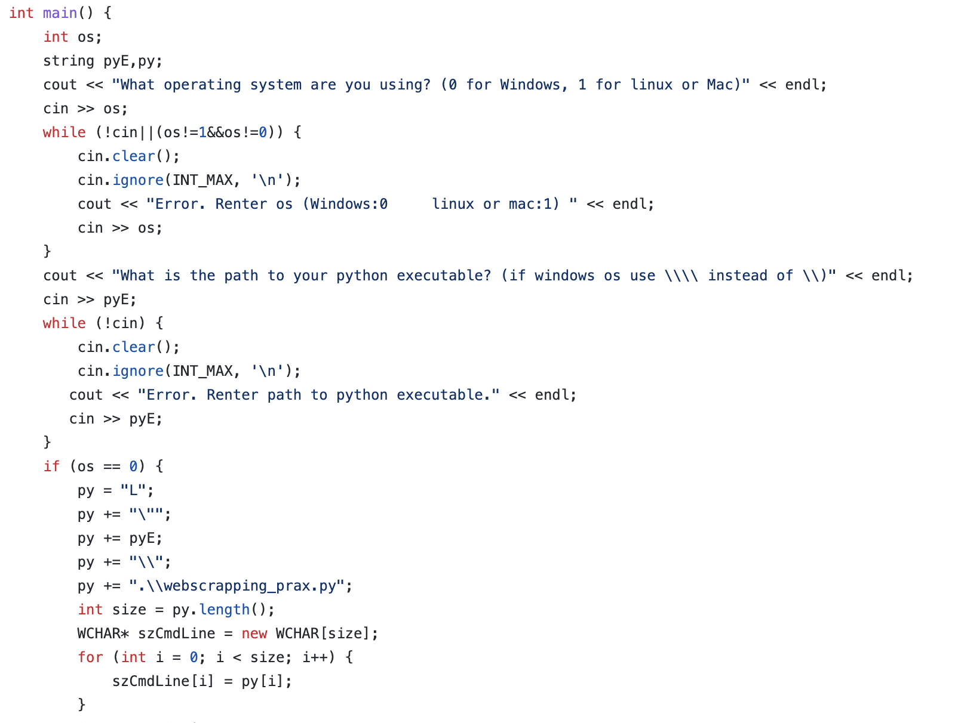
MAIN()

Slide 12
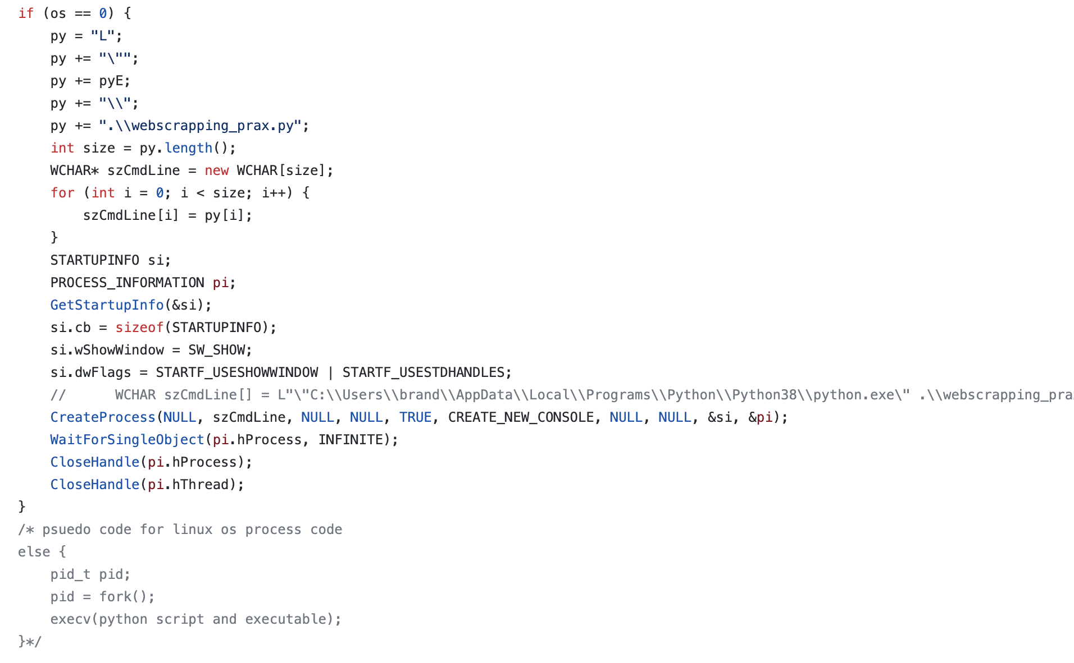

Slide 13
